Slide 1
MCC’s Course Enrollment Data: An Event Analysis
By Chris Tapia

Slide 2

What’s Going On?
Are you a college professor?
Are you wondering why there aren’t as many student enrolled this semester?
You may even be noticing a pattern with this particular course.
Now you’re probably playing the guessing game, maybe you even think it’s you!
This Photo by Unknown Author is licensed under CC BY-NC-ND

Slide 3

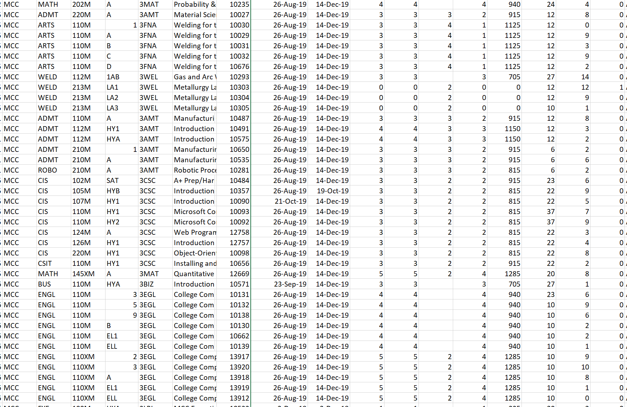



Let’s Look at the Data!
To get answers, we can look to the data
Raw data is unorganized and difficult to visualize
Doesn’t give us answers to our problem!
How can we filter this data and grab only what we need while also showing us what it means?

Slide 4


Python and Pandas
I developed a program using Python and Pandas
Pandas is an essential Data Science tool
I use it to import the CSV with all the data and even have the user decide how many files of that data too look through and what course or subject they want to look at
Now we can start looking at a range of data to compare
This Photo by Unknown Author is licensed under CC BY-SA

Slide 5
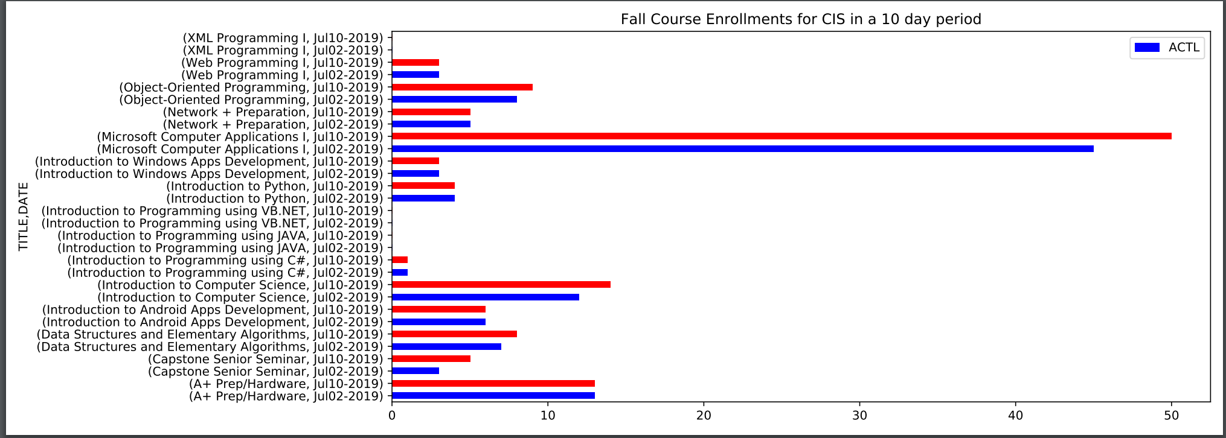
Subject Enrollments
When you run the program, if you choose the option to see the data for a subject (showing all the courses under that subject), it will display all the courses enrollment data
You then choose how many days back you want to compare it to.
The horizontal bar graph, displayed to the right, will pop up and be saved for you as well
It’s color coded and the two course dates are next to each other for easy viewing

Slide 6
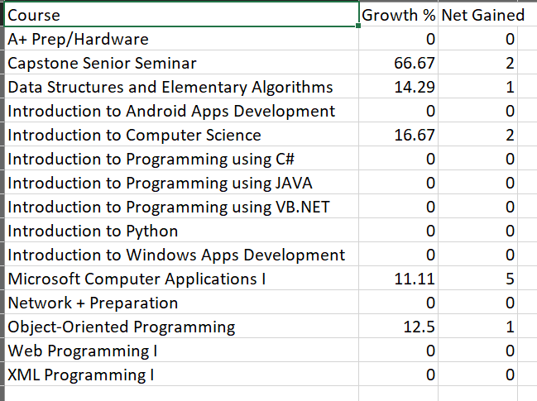
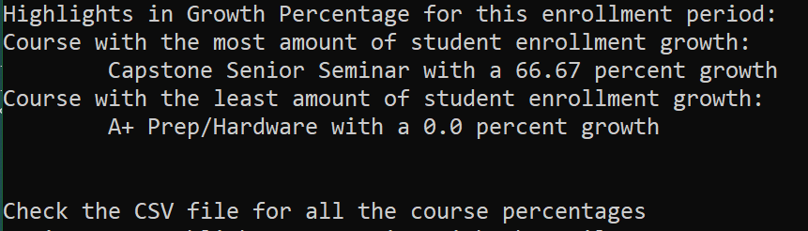
Subject Growth & Highlights
Upon running that subject data comparison, a printed section called “Highlights” will display the course with the most growth and then the one with the least growth
You’ll also have the Subject Growth CSV file you can look at to get a rundown of all the courses, their growth percentage and the net additions of that period
Highlights

Slide 7
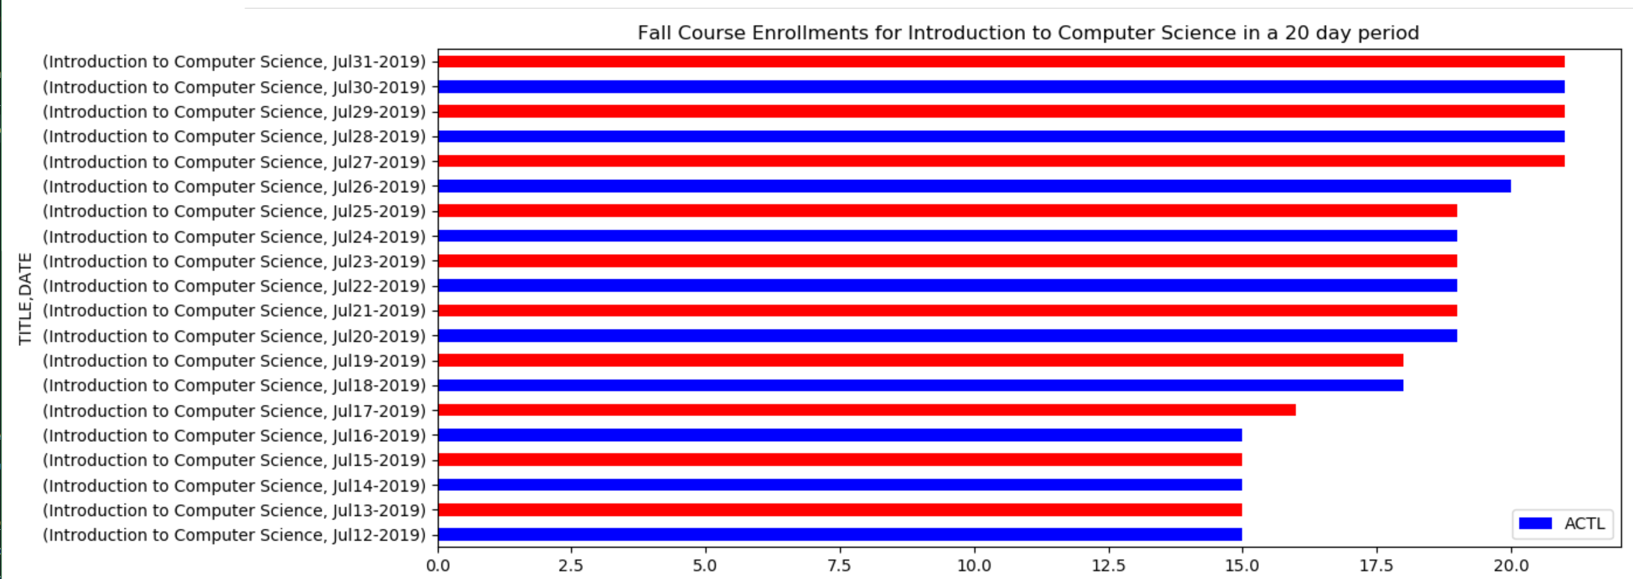
Course Enrollments
When you run the program, if you choose the option to see the data for a specific course, it will display all the days for the amount that you choose to go back to unlike the Subject function
To show you a gradual representation of that data instead of two different dates
More detail!

Slide 8
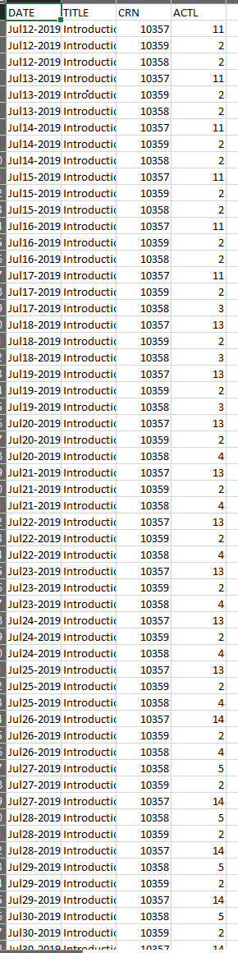
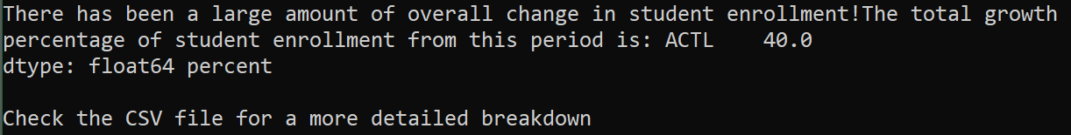
Course Data & Summary
The approach for the specific course data was to get detail.
On the left, you have the CSV file that gives you a complete breakdown with CRN to see their numbers and on what day. The Graph just provides a quick visual giving totals.
The right image is the summary, giving a message based on the Standard Deviation of the course’s enrollment
A growth percentage is also displayed in the summary

Slide 9
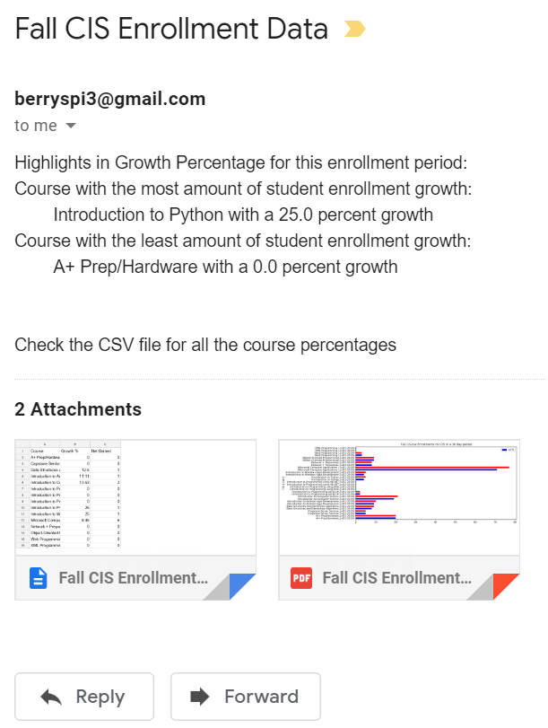
Sending Emails!
Well now that you’ve seen the data, what now?
You can choose to input your email and even to your colleagues!
This makes it easy so you can revisit crucial data that you would either like to review later or share it to reveal areas of opportunities!
As shown in the image, the Subject displays the data detail, the body shows your summary or highlights, and attached is your graph and new CSV file.

Slide 10

I’ve Learned So Much!
This project had me utilize almost all the concepts I’ve learn so far. I learned to innovate and to use Python with efficient data structures
This provided me with a real-world experience developing real solutions that can helps others, makes their lives easier and in turn help a business grow
What I would do next time, is start by building my main Class and __init__ first to declare which variables I might use and go from there. That way I don’t have to clean the code up afterwards as much.
This Photo by Unknown Author is licensed under CC BY-SA

